Slide 1


Efficient Contact Management: Developing a User-Friendly Phonebook Application with Qt and SQLite

Slide 2


Phonebook
22-CS-039
22-CS-071
22-CS-035
22-CS-015

Slide 3
Introduction
Welcome to our presentation on the Semester Project Submission for our Phonebook Application.
Team Members
Faisal Khan
Muhammad Afzal
Muhammad Zain Ali
Abdul Ahad

Slide 4
Project Objectives
Explain the specific objectives of our project:
Develop a user-friendly phonebook application.
Implement functionalities for adding, searching, updating, and deleting contact entries.
Integrate a SQLite database for data storage and retrieval.
Ensure input validation, error handling, and code robustness.

Slide 5
Methodology
The step-by-step approach we followed to develop the phonebook application:
Project planning and requirements analysis.
GUI design using Qt's UI components for an intuitive interface.
Integration of SQLite database for efficient data management.
Implementation of core features: add, search, update, and delete entries.
Testing, debugging, and quality assurance.
Documentation preparation for future reference and maintenance.

Slide 6
Application Overview
An overview of the phonebook application:
Showcase the user interface design and highlight its user-friendly features.
Explain how users can add, search, update, and delete contact entries effortlessly.
Discuss the benefits of integrating a SQLite database for seamless data storage and retrieval.

Slide 7
Implementation Details
The main components of the application and their roles:
MainWindow: Handles the graphical user interface (GUI) implementation using Qt widgets.
Phonebook: Manages the database operations, such as adding, searching, updating, and deleting entries.
main.cpp: Entry point of the application.

Slide 8
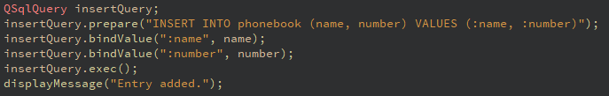


Code Walkthrough
Adding Entry

Slide 9
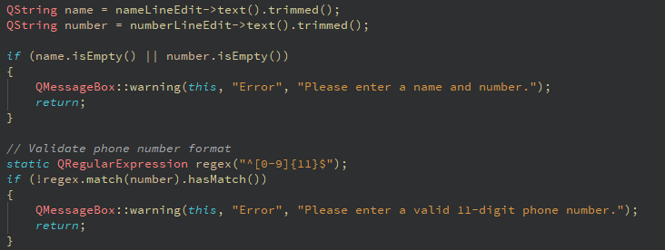
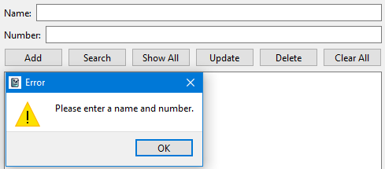
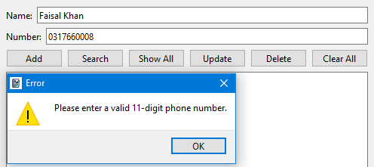
Validation Check

Slide 10
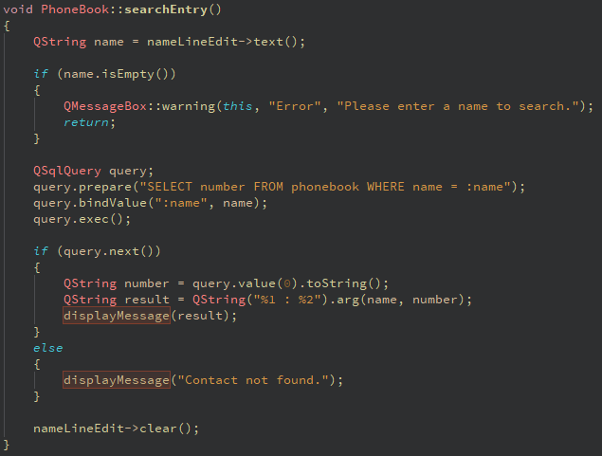
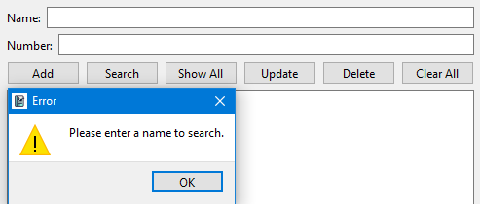

Searching contacts:

Slide 11
Conclusion and Future Scope
The achievements of the project:
Successful development of a user-friendly phonebook application.
Efficient management of contact information with the integration of SQLite database.

Slide 12
Potential future enhancements or features that could be added to the application
Implement a search functionality that allows users to search for contacts by name or number.
Add a feature to import and export contacts from/to a file in a specific format (e.g., CSV or JSON).
Include validation checks for the input fields to ensure that users enter valid names and numbers.
Implement sorting options to sort the contacts alphabetically or by number.
Allow users to edit and delete existing contacts from the phone book.
Improve the user interface by adding icons, tooltips, and keyboard shortcuts for common actions.
Add additional fields for contacts, such as email addresses, addresses, or notes.
Implement a feature to categorize contacts into groups or add tags to contacts.
Enhance the GUI by applying custom styles and themes using Qt's style sheets.
Consider adding features like contact duplication checks, contact merging, or contact backup and restore.

Slide 13
THE END

